Slide 1
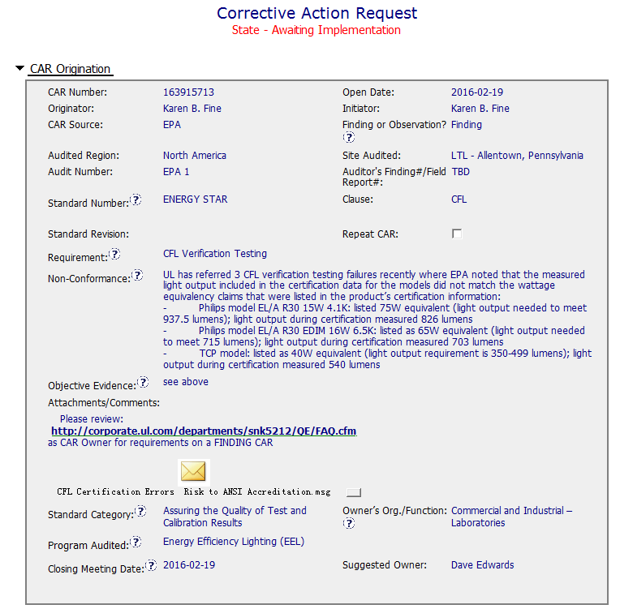
CAR 163915713
Didn’t indicate the standard no., e.g. Energy Star Lamps V2.0 or Energy Star Integral LED Lamps V1.4
Didn’t assign Finding #
Didn’t indicate the standard requirement and the clause, e.g. Energy Star Program Requirement for Lamps (Light Bulbs) Clause 9.2 or Integral LED Lamps Clause 7c
Didn’t indicate the clause no. CFL only an abbreviation of Compact Fluorescent Lamp
#1
Non-conformance statement is clear
#2
Good to attach some investigations or discussion information related to this NC. But recommend to include the standard / specification requirement
Wrong selection of standard category. Should select “Conformity Assessment Decision”

Slide 2
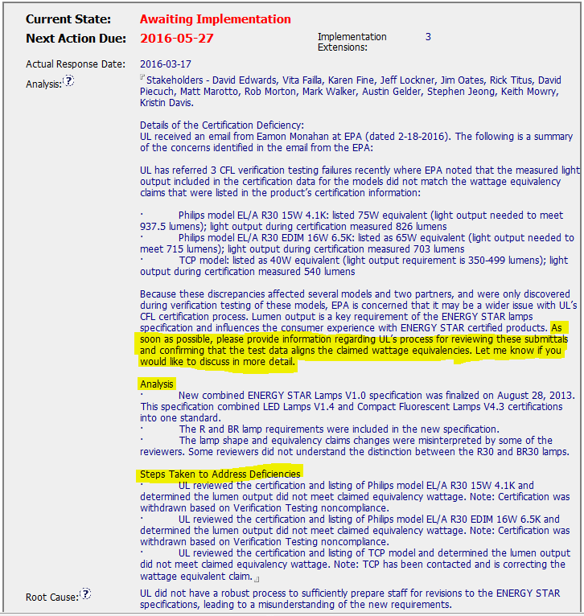
CAR 163915713
#1
Analysis was not clear. It just stated the facts. It didn’t address to the NC issues (i.e. the measured light output not matched with the wattage equivalency claim)
Analysis didn’t mention whether the certification deficiency was caused by referencing to wrong or outdated ENERGY STAR Lamps specifications for evaluation. For example, R lamp should refer to LED Lamps V1.4 whereas BR lamp should refer to CFL V4.3 specification.
Analysis didn’t mention how the reviewers mixed the requirements of R30 and BR30 lamps.
Analysis was mixed up with Containment Action and was very dispersed.
Key stakeholders were involved
BR30
(x 10)
R30
(x 12.5)
Avoid to request information. The owner should collect all related information during analysis
Put it into containment action
Root cause statement was precise but cannot see it is concluded from Analysis

Slide 3
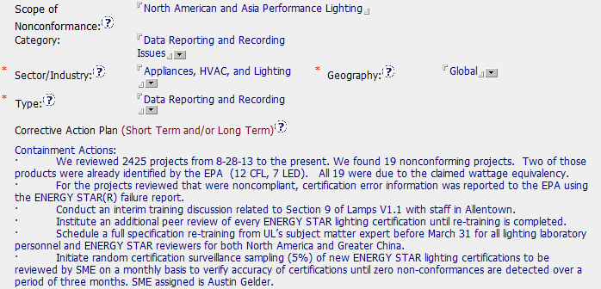
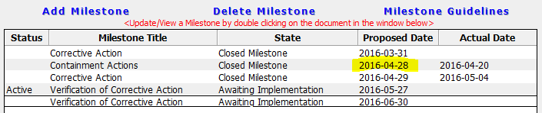
CAR 163915713
#2
Category - Should select Evaluation / Review (Technical)
Type - Should select Project Review / Evaluation
Mixed Corrective Action Plan
Containment Action
Corrective Action
Verification
#3
Containment action should be completed the earliest
Corrective Action Plan’s items not matched with the milestones. Milestones actions repeated and have some other corrective actions added.

Slide 4
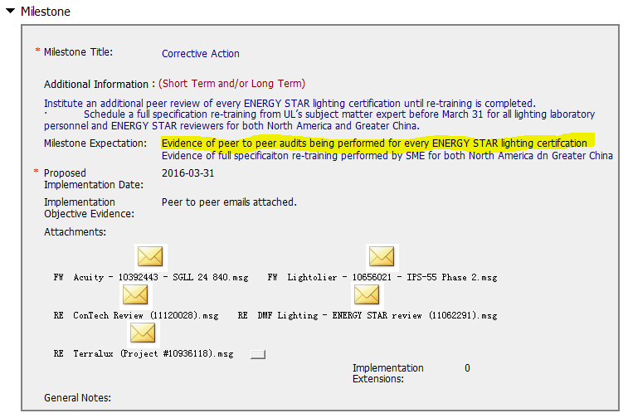
CAR 163915713 – Milestone 1
#4
2 actions & 2 milestone expectation mentioned but only one completed but the milestone was still approved.

Slide 5
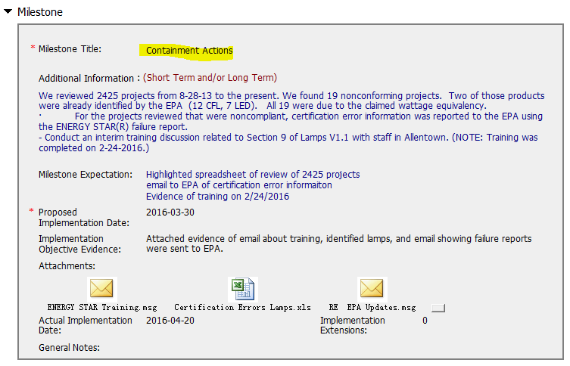
CAR 163915713 – Milestone 2
3 actions and 3 milestone expectation mentioned, completed as per milestone expectation mentioned with evidence attached

Slide 6
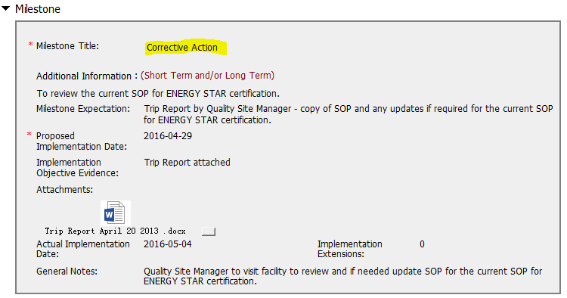
CAR 163915713 – Milestone 3
This milestone hasn’t been mentioned in the CAP or analysis.

Slide 7
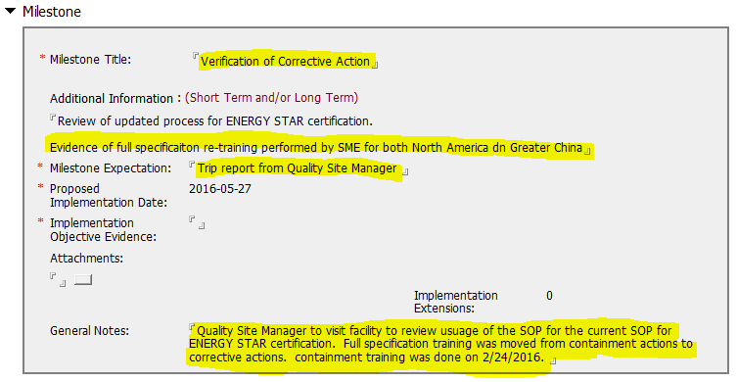
CAR 163915713 – Milestone 4
This verification milestone not matched with CAP description
Very confusing and disorganized – The first action was overlapped with milestone 3. Additional action was added in this milestone
#3
A note here to explain the confusing milestones

Slide 8
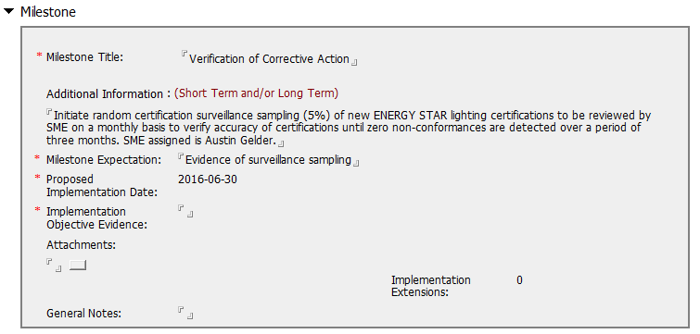
CAR 163915713 – Milestone 5
Okay

Slide 9
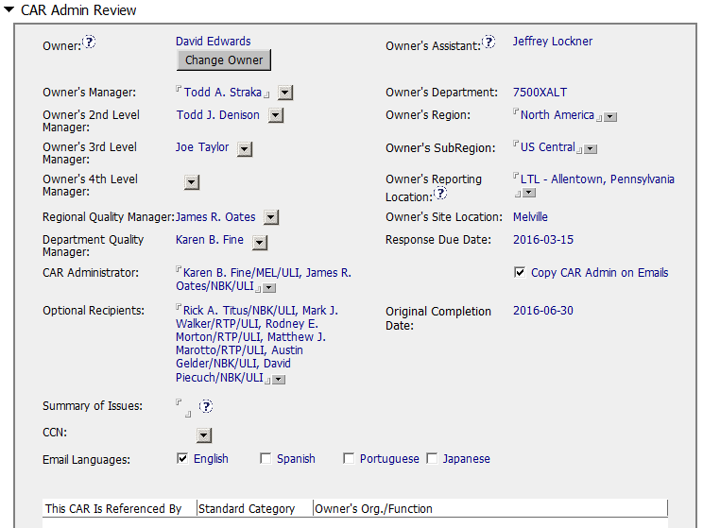
CAR 163915713
Okay

Slide 10
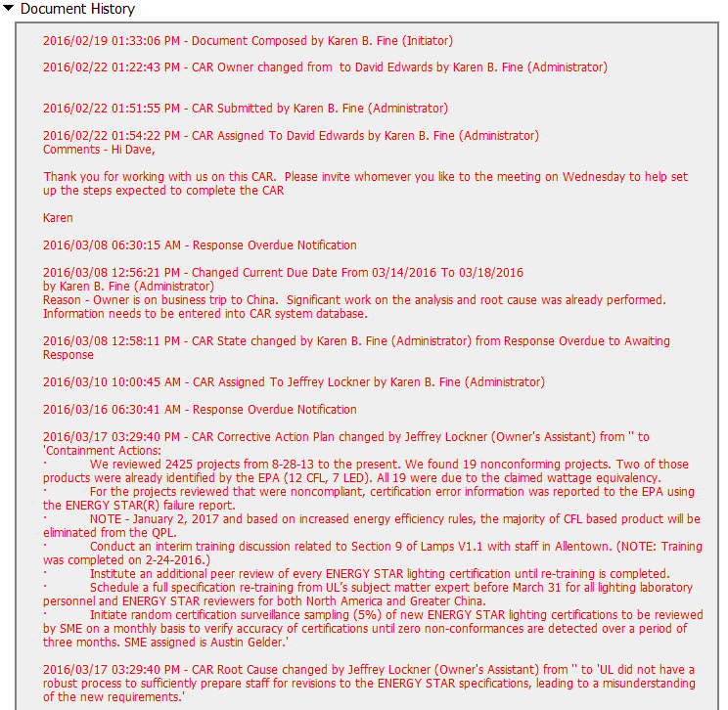
CAR 163915713
Response Overdue x 2

Slide 11
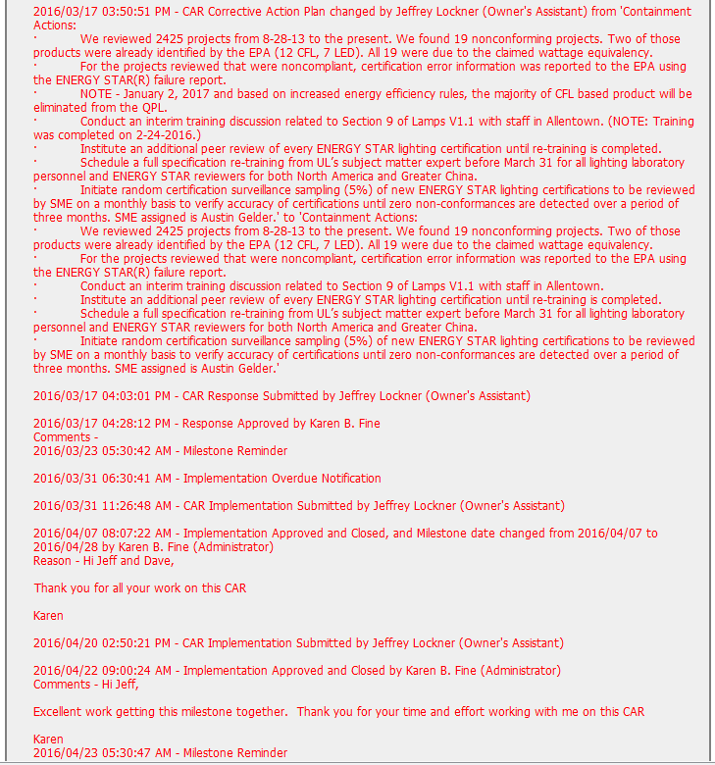

CAR 163915713
Implementation Overdue x 2

Slide 12
CAR 163915713 – CBS Check
CBS Requirements | Excellent | Moderate | Need Improve | N/A
(C) Extensions are within requirement (<30 days, 3 or less) |  |  |  | √
(T) Most appropriate ‘category’, ‘type’, ‘geography’ are selected |  |  | √
(P) Facilitates the handling of disputed CARs |  |  |  | √
(T) Acts on CARs within required timeframe |  |  | √
(C) Analysis shows clear path to root cause and scope; stakeholders identified |  |  | √
(C) Root cause statement is succinct, reasonable, complete (Shows ‘N/A’ for observations) |  | √
(C) Corrective actions fix the objective evidence and other problems found; address entire root cause and scope. For observations, they do not go beyond fixing the objective evidence |  | √
(C) Milestones address containment & owner’s verification; completed per milestone expectations |  |  | √
(P) Verification per requirements |  |  |  | √
(L) Referenced communications are attached as needed | √
(C L) Evidence of communication for overdue/escalated CARs and other pertinent concerns |  | √
(P) Trains other CAR Champions |  |  |  | √

Slide 13
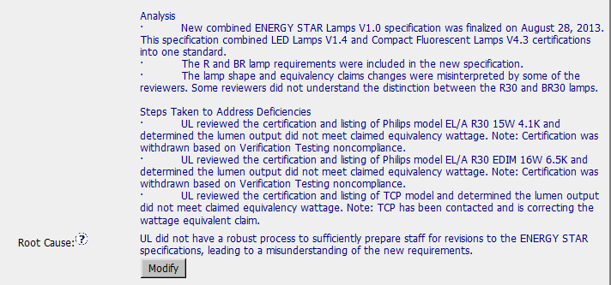

Slide 14
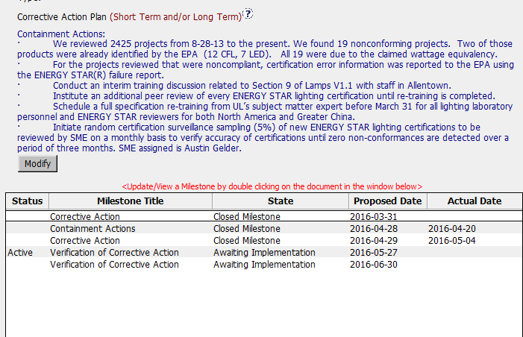
Corrective action
verification
All actions were included into the containment, it is better to separate as:
Containment
Corrective action
Verification
As it was done with milestones.

Slide 15
Proposed actions are good!!
Comments:
what will assure proper training and competency of staff in the future?
There was training given, but was there any competency requirement for new staff to get this training, or for any periodic training?
what is going to be driving this training and competency in the future

